Slide 1
Human Disease Detection
Submitted in the partial fulfillment for the award of the degree of
BACHELOR OF ENGINEERING
IN
Artificial Intelligence and Machine Learning in association with IBM
Submitted by:
Harshit Kumar (22BAI70085)
Akansha Rohilla (22BAI70092)
Shubham Sharma (22BAI70002)
Yudhisthir (22BAI70012)
Under the Supervision of:
Kirti (E16189)
Department of AIT-CSE
DISCOVER . LEARN . EMPOWER

Slide 2
Outline
Introduction to Project
Problem Formulation
Objectives of the work
Methodology used
Challenges
Expected Outcomes
References

Slide 3
Introduction to Project
Human Healthcare is one of the most significant subjects of society.The identification of the nature of the illness or other problems by examination of the symptoms i.e. diagnosis always stands first in overall curing procedure of disease. Thus , we can say that diagnosis and prediction of disease are most crucial aspects to be considered before thinking about exact procedure of curing the disease. This diagnosis procedure requires a lot of time as well as a lot of money. As a result , people belonging to poor financial background are not able to get accurate diagnose of disease which at the end may create life or death situation. So this is basically a Human Disease Detection model which is supposed to input symptoms regarding to the patient and in response to that it gives type of disease that person is having as an output. So , this model will be salutary to people who are not able to pay huge amounts to get diagnosed as well as the ones who requires immediate diagnosis.

Slide 4
Problem Formulation
The problem revolves around developing a robust ML-based system that can accurately identify various human diseases from medical data. The system should be capable of processing diverse types of data such as patient demographics, medical history, symptoms, diagnostic test results, and possibly imaging data etc. The primary goal is to build a model that aids healthcare professionals in diagnosing diseases accurately and efficiently.

Slide 5
Objectives of the Work
Develop a comprehensive dataset containing labeled medical data encompassing various diseases, symptoms, and relevant patient information.
Explore and preprocess the dataset to handle missing values, outliers, and ensure data consistency.
Identify suitable ML algorithms and techniques for disease detection, considering factors such as interpretability, accuracy, and scalability.
Train ML models using the preprocessed dataset and evaluate their performance through appropriate metrics such as accuracy, precision, recall.
Optimize model parameters to enhance performance and generalization capabilities.
Develop a user-friendly interface or API that integrates the trained ML model, allowing healthcare professionals to input patient data and receive disease predictions promptly.

Slide 6
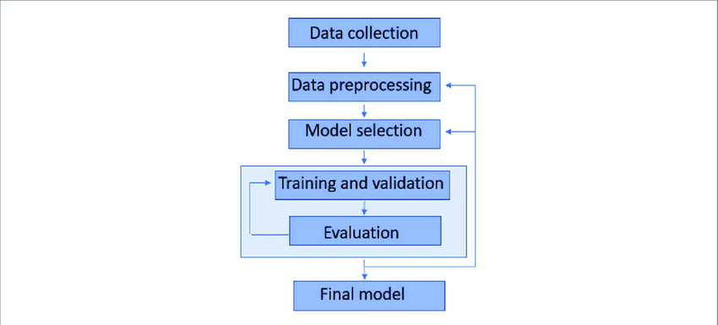
Methodology used

Slide 7
Methodology used
Data Collection: Gather relevant medical data from reputable sources such as hospitals, clinics, research institutions, and publicly available datasets.
Data Preprocessing: Cleanse and preprocess the dataset by handling missing values, encoding categorical variables, scaling numerical features, and performing feature engineering if necessary.
Model Selection: Experiment with various ML algorithms such as decision trees, KNN, random forests, neural networks, etc., to determine the most suitable approach for disease detection.

Slide 8
Model Training and Evaluation: Split the dataset into training and testing sets, train the selected models on the training data, and evaluate their performance using appropriate evaluation metrics.
Model Optimization: Fine-tune model parameters and hyperparameters using techniques like grid search, random search, or Bayesian optimization to improve performance and generalization capabilities.
Deployment: Develop a user-friendly interface or API that integrates the trained ML model, allowing seamless interaction with healthcare professionals for real-time disease detection.

Slide 9
Challenges
Limited Availability of Labeled Data: Acquiring labeled medical data for training ML models can be challenging due to privacy concerns and data scarcity.
Data Heterogeneity: Medical data often exhibit high variability and heterogeneity, making it challenging to preprocess and model effectively.
Model Interpretability: Ensuring interpretability of ML models is crucial in the healthcare domain to facilitate trust and understanding among healthcare professionals.
Regulatory Compliance: Adhering to regulatory standards and compliance requirements such as HIPAA (Health Insurance Portability and Accountability Act) is essential to safeguard patient privacy and data security.

Slide 10
Expected Outcomes
The expected outcome is a robust ML-based system capable of accurately detecting various human diseases based on relevant medical data. The system should demonstrate high accuracy, sensitivity, and specificity across different disease categories, thereby assisting healthcare professionals in making informed decisions and improving patient outcomes.

Slide 11
References
1. https://www.researchgate.net/publication/349054979_Human_Diseases_Detection_Based_On_M ach ine_Learning_Algorithms_A_Review
2. https://towardsdatascience.com/supervised-vs-unsupervised-learning-14f68e32ea8d Acharya, U. R., Fujita, H., Oh, S. L., Hagiwara, Y., Tan, J. H., & Adam, M. (2017). Application ofdeep convolutional neural network for automated detection of myocardial infarction using ECG signals. InformationSciences, 415–416, 190–198. https://doi.org/10.1016/j.ins.2017.06.027
3. Ahmed, S., Choi, K. Y., Lee, J. J., Kim, B. C., Kwon, G. R., Lee, K. H., & Jung, H. Y. (2019).Ensembles of Patch-Based
4. Classifiers for Diagnosis of Alzheimer Diseases. IEEE Access, 7, 73373–73383. 8. https://doi.org/10.1109/ACCESS.2019.2920011 5. Al-Zebari, A., & Sengur, A. (2019).

